Slide 1



Python 3 Beginner
Chapter 00
Previously, on Python 3 Beginner…
release 1.0.0
37/39 Avenue Ledru Rollin – CS 11237 – 75750 PARIS CEDEX 12 - info@valnaos.com – www.valnaos.com Tél : 01 86 95 20 48

Slide 2

What we saw last time
Python 3 Beginner
The NoneType dataype and its only value: None
The bool type and its 2 values: True and False
Comparing values with operators: ==, !=, <, in...
Combining bool values with logical operators: and and or
Conditionally running code with if, else, elif
Iterating over sequences with for
Looping on a condition with while
Short-circuiting loops with break and continue

Slide 3

Cloud Technology Associate
Copyright © 2018 | 9
Q&A
37/39 Avenue Ledru Rollin – CS 11237 – 75750 PARIS CEDEX 12 - info@valnaos.com – www.valnaos.com Tél : 01 86 95 20 48

Slide 4

Where? Who?
Python 3 Beginner
Class Material
GitHub: https://github.com/cstar-industries/python-3-beginner
Instructor
Charles Francoise <charles@cstar.io>

Slide 5

Session Objectives
Python 3 Beginner
At the end of this session, you will be able to:
Master the list type
Use str to its full potential
Use and recognize the tuple type for immutable ordered lists
Use the set type to perform efficient inclusion tests and set arithmetic
Use and master the dict type to associate arbitrary keys and values
Wield Python superpowers like list comprehensions and more...

Slide 6
Session Syllabus
Python 3 Beginner
Chapter | Subject | Start | End | Total Time (in hours)
00 | Previously on Python 3 Beginner… | 14:00 | 14:30 | 00:30
01 | More about list | 14:30 | 15:00 | 00:30
02 | Other sequence types: str – tuple – set | 15:00 | 15:45 | 00:45
 | Coffee Break | 15:45 | 16:00 | 00:15
03 | Associative container: dict | 16:00 | 16:30 | 00:30
04 | Mastering container types | 16:30 | 17:00 | 00:30
 | Coffee Break | 17:00 | 17:15 | 00:15
 | Workshop | 17:15 | 18:00 | 00:45
 | Total |  |  | 04:00

Slide 7
Python 3 Beginner
Chapter 01
More about list
release 1.0.0
37/39 Avenue Ledru Rollin – CS 11237 – 75750 PARIS CEDEX 12 - info@valnaos.com – www.valnaos.com Tél : 01 86 95 20 48

Slide 8
list: what we already know
Python 3 Beginner
Test inclusion with in and not in
'toto' in [0, 3.33, False, 'toto', []]
True
Extend with + and *
[1, 2] + [3]
[1, 2, 3]
3 * [1, 2]
[1, 2, 1, 2, 1, 2]

Slide 9
list: what we already know
Python 3 Beginner
Get list length with len()
len(['Hello', 'World', '!'])
3
Extract items with []
l = [0, 1, 2, 3, 4, 5, 6, 7, 8, 9]
print(l[2])
print(l[:2])
print(l[1:8:2])
2
[0, 1]
[1, 3, 5, 7]

Slide 10
list: methods and built-in functions
Python 3 Beginner
Find the first occurrence of an item: l.index
l = ['H', 'e', 'l', 'l', 'o']
l.index('l')
2
Return the number of occurrences of an item: l.count
print(l.count('l'))
print(l.count('J'))
2
0

Slide 11
list: methods and built-in functions
Python 3 Beginner
Get the largest and smallest items: max and min
l = [9, 2, 8, 5, 0, 1, 4, 7, 6, 3]
print(min(l), max(l))
0 9
Add all items together: sum
sum([1, 2, 5, 10])
18

Slide 12
Let’s write some code!
Python 3 Beginner
from random import shuffle
l = [0, 1, 2, 3, 4, 5, 6, 7, 8, 9]
shuffle(l)
print(l)
print(f'max value: {max(l)}, min value: {min(l)}')
[3, 6, 0, 1, 5, 7, 8, 9, 2, 4]
max value: 9, min value: 0
Notes:
* The `print` function outputs whatever we tell it to

Slide 13
list is a mutable object
Python 3 Beginner
Replace items at indexes or ranges
l = [0, 1, 2, 3, 4]
l[1] = 'toto'
print(l)
[0, 'toto', 2, 3, 4]
l[2:4] = [8, '8', 'eight']
print(l)
[0, 'toto', 8, '8', 'eight', 4]
l[1:5] = []
print(l)
[0, 4]

Slide 14
list is a mutable object
Python 3 Beginner
Delete items at indexes or ranges
l = [0, 1, 2, 3, 4]
del l[1]
print(l)
[0, 2, 3, 4]
del l[:2]
print(l)
[3, 4]

Slide 15
list is a mutable object
Python 3 Beginner
Add and remove items at the end of the list
l = [0, 1, 2, 3, 4]
l.append(5)
print(l)
[0, 1, 2, 3, 4, 5]
a = l.pop()
print(l)
print(a)
[0, 1, 2, 3, 4]
5

Slide 16
list is a mutable object
Python 3 Beginner
Add and remove items at an arbitrary position
l = [0, 1, 2, 3, 4]
l.insert(1, 5)
print(l)
[0, 5, 1, 2, 3, 4]
a = l.pop(3)
print(l)
print(a)
[0, 5, 1, 3, 4]
2

Slide 17
list is a mutable object
Python 3 Beginner
Remove the first occurrence of an item
l = ['H', 'e', 'l', 'l', 'o']
l.remove('l')
print(l)
['H', 'e', 'l', 'o']
Copy a list
a = [0, 1, 2, 3, 4]
b = a.copy()
print(b)
print(a is b)
[0, 1, 2, 3, 4]
False

Slide 18
list is a mutable object
Python 3 Beginner
Remove all elements from a list
l = ['H', 'e', 'l', 'l', 'o']
print(l)
l.clear()
print(l)
['H', 'e', 'l', 'l', 'o']
[]

Slide 19
Let’s write some code!
Python 3 Beginner
a = [0, 1, 2, 3, 4, 5]
b = a.copy()
print(a) print(b)
print(a == b)
print(a is b)
[0, 1, 2, 3, 4, 5]
[0, 1, 2, 3, 4, 5]
True
False
Notes:
* The `print` function outputs whatever we tell it to

Slide 20
⚠️ Mutability can be dangerous ⚠️
Python 3 Beginner
If an object is mutable, changing it in one place also changes in in another.
a = [0, 1, 2, 3, 4]
b = a
last_item_of_b = b.pop()
print(b)
print(a)
[0, 1, 2, 3]
[0, 1, 2, 3]

Slide 21
⚠️ Mutability can be dangerous ⚠️
Python 3 Beginner
Whenever possible, use copy to preserve the original object.
a = ['Hello', 'hello', 'hi']
b = a.copy()
print(a == b)
print(a is b)
a.pop()
print(b)
True
False
['Hello', 'hello', 'hi']

Slide 22
⚠️ Mutability can be dangerous ⚠️
Python 3 Beginner
Beware! copy is shallow
a = [['a', 'b'], ['a', 'c'], ['b', 'c']]
b = a.copy()
print(a == b)
print(a is b)
print(a[0] is b[0])
b[0][0] = None
print(a)
True
False
True
[[None, 'b'], ['a', 'c'], ['b', 'c']]

Slide 23
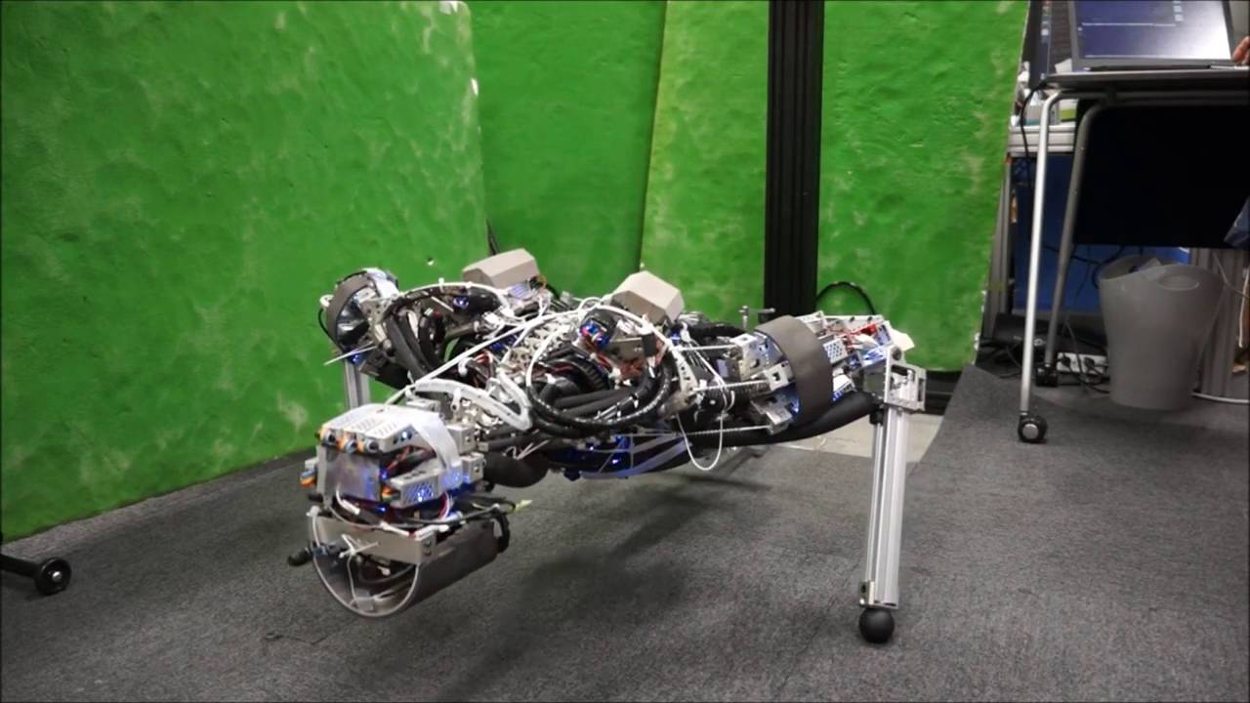
Workout Time!
Python 3 Beginner
Chapter 1 Exercises link
Notes:
https://github.com/cstar-industries/python-3-beginner/blob/master/001-First-Steps/First%20Steps%20-%20Chap%2001%20-%20Exercises.ipynb

Slide 24
Chapter Summary
Python 3 Beginner
This chapter covered the following:
The list type has many powerful features built into it.
list is mutable and can change during its lifetime.
⚠️ Mutability is dangerous.

Slide 25
Python 3 Beginner
Chapter 02
More sequence datatypes
release 1.0.0
37/39 Avenue Ledru Rollin – CS 11237 – 75750 PARIS CEDEX 12 - info@valnaos.com – www.valnaos.com Tél : 01 86 95 20 48

Slide 26
An immutable sequence type: tuple
Python 3 Beginner
A tuple is very similar to a list, but it is immutable
It is most often written as a comma-separated series of values between parentheses
t = (0, 1, 2)
print(t)
print(type(t))
(0, 1, 2)
tuple

Slide 27
An immutable sequence type: tuple
Python 3 Beginner
Parentheses are optional
t = 0, 1, 2
print(t)
print(type(t))
(0, 1, 2)
tuple

Slide 28
An immutable sequence type: tuple
Python 3 Beginner
Use a comma for a single-item tuple
t = (0,)
print(t)
(0,)
Use empty parentheses for an empty tuple
t = ()
print(t)
()

Slide 29
An immutable sequence type: tuple
Python 3 Beginner
tuples can be used to destructure other sequences at assignment
(a, b, c) = range(3)
print(a)
print(b)
print(c)
0
1
2
You've already met tuple before...
for i, x in enumerate(l):
...

Slide 30
tuple is like list
Python 3 Beginner
Iteration with for
for x in t:
...
Indexation with []
t[0]
t[-2:]
Inclusion with in
0 in (0, 1, 2)
1138 not in (3,)

Slide 31
tuple is unlike list
Python 3 Beginner
tuple is immutable
t = (0, 1, 2)
t[0] = 'toto'
TypeError: 'tuple' object does not support item assignment
t.pop()
AttributeError: 'tuple' object has no attribute 'pop'

Slide 32
Let’s write some code!
Python 3 Beginner
t = (0, 1, 2)
print(t)
print(type(t))
(0, 1, 2)
<class 'tuple'>

Slide 33
More about str
Python 3 Beginner
Match prefix and suffix
filename = 'sensor_data.csv'
print(filename.startswith('Sens'))
print(filename.endswith('.csv'))
True
False
Find occurrence of a substring inside a string
print(filename.find('data'))
print(filename.find('hello'))
7
-1

Slide 34
More about str
Python 3 Beginner
Quickly validate the content of a string
isalpha: checks if all characters are letters
isnumeric, isdigit, isdecimal: checks if all characters are numeric, digits, decimal digits, respectively
isalnum: checks if all characters are either letter or numeric
isupper, islower: checks if all character are upper or lowercase
isspace: checks if all characters are whitespace

Slide 35
More about str
Python 3 Beginner
s = 'hello'
print(s.isalpha())
print(s.isnumeric())
print(s.isalnum())
print(s.isupper())
print(s.islower())
True
False
True
False
True

Slide 36
More about str
Python 3 Beginner
Split strings into a list of strings, separated by a delimiter
languages = 'C,C++,Java,Python,Go'
data.split(',')
['C', 'C++', 'Java', 'Python', 'Go']
Join a list of strings using a delimiter
languages = '\n'.join(languages)
print(languages)
C
C++
Java
Python
Go

Slide 37
More about str
Python 3 Beginner
Replace all occurrences of a substring in a string by another
languages = 'C,C++,Java,Python,Go'
languages.replace(',', '\n')
print(languages)
C
C++
Java
Python
Go

Slide 38
Let’s write some code!
Python 3 Beginner
filename = 'toto.txt'
print(filename.startswith('hello'))
print(filename.endswith('.txt'))
False
True

Slide 39
set
Python 3 Beginner
An unordered set of distinct objects
s = set([1, 2, 3])
print(s)
{1, 2, 3}
s1 = {3, 2, 1}
print(s1)
print(s == s1)
{1, 2, 3}
True
print({1, 1, 1, 1, 1, 1})
{1}

Slide 40
set
Python 3 Beginner
Test inclusion
s = {1, 2, 3}
print(1 in s)
print(0 in s)
True
False
No indexing
s[0]
TypeError: 'set' object does not support indexing

Slide 41
set
Python 3 Beginner
Iteration
s = set('Python')
for c in s:
print(c)
P
t
o
y
n
h

Slide 42
set is mutable
Python 3 Beginner
add an item to the set
s = set()
s.add(1)
print(s)
{1}
s = {1, 2, 3}
s.add(1)
print(s)
{1, 2, 3}

Slide 43
set is mutable
Python 3 Beginner
remove an item from the set
s = {1, 2, 3}
s.remove(1)
print(s)
{2, 3}
s.remove('a')
KeyError: 'a'
remove all items from the set
s.clear()
print(s)
set()

Slide 44
Set arithmetic
Python 3 Beginner
Cobra
C
sneks
Python
languages
Anaconda
Go
sneks = {'Python', 'Cobra', 'Anaconda'}
languages = {'Python', 'C', 'Go'}

Slide 45
Union "OR"
Python 3 Beginner
Cobra
C
sneks
Python
languages
Anaconda
Go
sneks | languages
{'Cobra', 'Anaconda', 'Go', 'C', 'Python'}

Slide 46
Intersection "AND"
Python 3 Beginner
Cobra
C
sneks
Python
languages
Anaconda
Go
sneks & languages
{'Python'}

Slide 47
Difference
Python 3 Beginner
Cobra
C
sneks
Python
languages
Anaconda
Go
sneks - languages
{'Anaconda', 'Cobra'}

Slide 48
Difference
Python 3 Beginner
Cobra
C
sneks
Python
languages
Anaconda
Go
languages - sneks
{'C', 'Go'}

Slide 49
Exclusive disjunction "XOR"
Python 3 Beginner
Cobra
C
sneks
Python
languages
Anaconda
Go
languages ^ sneks
{'C', 'Cobra', 'Anaconda', 'Go'}

Slide 50
set is mutable
Python 3 Beginner
Use assignment operators to mutate
languages |= {'C++', 'Java'}
print(languages)
{'Go', 'C', 'Python', 'Java', 'C++'}
⚠️ Watch out for mutability!
s = languages
print(s is languages)
s &= sneks
print(s)
print(languages)
True
{'Python'}
{'Python'}

Slide 51
Let’s write some code!
Python 3 Beginner
print('Union:', sneks | languages)
print('Intersection:', sneks & languages)
print('Left difference:', sneks - languages)
print('Right difference:', languages - sneks)
print('Exclusion:', languages ^ sneks)
print('Exclusion:', (languages | sneks) - (languages & sneks))
Union: {'Cobra', 'Anaconda', 'Go', 'C', 'Python'}
Intersection: {'Python'}
Left difference: {'Anaconda', 'Cobra'}
Right difference: {'C', 'Go'}
Exclusion: {'C', 'Cobra', 'Anaconda', 'Go'}
Exclusion: {'Anaconda', 'Cobra', 'C', 'Go'}

Slide 52
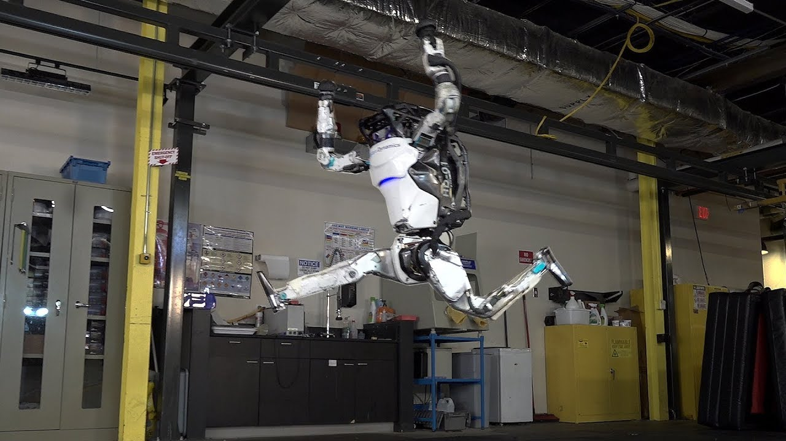
Workout Time!
Python 3 Beginner
Chapter 2 Exercises link
Notes:
https://github.com/cstar-industries/python-3-beginner/blob/master/001-First-Steps/First%20Steps%20-%20Chap%2002%20-%20Exercises.ipynb

Slide 53
Chapter Summary
Python 3 Beginner
This chapter covered the following:
More about the string type str
The immutable sequence type tuple
The unordered list type set
Using set to its full potential

Slide 54
Python 3 Beginner
Chapter 03
Associative container: dict
release 1.0.0
37/39 Avenue Ledru Rollin – CS 11237 – 75750 PARIS CEDEX 12 - info@valnaos.com – www.valnaos.com Tél : 01 86 95 20 48

Slide 55
An associative container: dict
Python 3 Beginner
Maps keys to values
Values can be any object
Keys can be almost any object (must be hashable)
Similar to C++ std::map, Java HashMap, Ruby hashes, JavaScript objects...
If you've used JSON, you've used dicts

Slide 56
dict basics
Python 3 Beginner
Creating a dictionary
d = {0: 'zero', 2: 'two', 1: 'one'}
type(d)
dict
d1 = {'one': 1, 'two': '2', 'three': 3.0, 'four': [4, 4, 4]}
print(d1)
{'one': 1, 'two': '2', 'three': 3.0, 'four': [4, 4, 4]}

Slide 57
dict basics
Python 3 Beginner
Dictionary creation & equality
d1 = {'one': 1, 'two': '2', 'three': 3.0, 'four': [4, 4, 4]}
print(d1)
{'one': 1, 'two': '2', 'three': 3.0, 'four': [4, 4, 4]}
d2 = dict(one=1, four=[4, 4, 4], two='2', three=3.0)
print(d2)
print(d1 == d2)
{'one': 1, 'four': [4, 4, 4], 'two': '2', 'three': 3.0}
True
d2 = dict([('one', 1), ('four', [4, 4, 4]), ('two', '2'), ('three', 3.0)])
print(d3 == d1)
True

Slide 58
dict basics
Python 3 Beginner
Retrieving an item
d = {0: 'zero', 2: 'two', 1: 'one'}
d[2]
'two'
d['two']
KeyError: 'two'
print(d.get('two'))
None

Slide 59
Iterating dict
Python 3 Beginner
By keys
for k in d:
print(f'{k}=>{d[k]}', end=' ')
2=>two 1=>one 4=>four
By values
for v in d.values():
print(v, end=' ')
two one four
By key-value pairs
for k, v in d.items():
print(f'{k}=>{v}', end=' ')
2=>two 1=>one 4=>four

Slide 60
Let’s write some code!
Python 3 Beginner
for k, v in d.items():
print(f'{k}=>{v}', end=' ')
2=>two
1=>one
4=>four

Slide 61
Chapter Summary
Python 3 Beginner
This chapter covered the following:
The built-in Python mapping type: dict

Slide 62
Python 3 Beginner
Chapter 04
Container superpowers
release 1.0.0
37/39 Avenue Ledru Rollin – CS 11237 – 75750 PARIS CEDEX 12 - info@valnaos.com – www.valnaos.com Tél : 01 86 95 20 48

Slide 63
Converting sequence types
Python 3 Beginner
Tuple to list
list(('Hello', 'World'))
['Hello', 'World']
List to tuple
tuple([0, 1, 2])
(0, 1, 2)
List to set
set([0, 1, 0, 1, 2, 0, 1, 3])
{0, 1, 2, 3}

Slide 64
List comprehensions
Python 3 Beginner
Create new lists from concise expressions
[x*x for x in range(10)]
[0, 1, 4, 9, 16, 25, 36, 49, 64, 81]
books = ['1984', 'The Stranger', 'The Pragmatic Programmer']
prices = [9, 12.71, 22.1]
[(b, f'{p:.2f}') for b, p in zip(books, prices)]
[('1984', '9.00'),
('The Stranger', '12.71'),
('The Pragmatic Programmer', '22.10')]

Slide 65
List comprehensions
Python 3 Beginner
Use a condition
l = [91, 39, 40, 76, 48, 57, 32, 88, 67, 44]
[x for x in l if (x % 2) == 0]
[40, 76, 48, 32, 88, 44]
Iterate over 2 variables
[(x, y) for x in (0, 1, 2) for y in (1, 2, 3)]
[(0, 1), (0, 2), (0, 3), (1, 1), (1, 2), (1, 3), (2, 1), (2, 2), (2, 3)]
[(x, y) for x in (0, 1, 2) for y in (1, 2, 3) if x != y]
[(0, 1), (0, 2), (0, 3), (1, 2), (1, 3), (2, 1), (2, 3)]

Slide 66
List comprehensions
Python 3 Beginner
Use a condition
l = [91, 39, 40, 76, 48, 57, 32, 88, 67, 44]
[x for x in l if (x % 2) == 0]
[40, 76, 48, 32, 88, 44]
Iterate over 2 variables
[(x, y) for x in (0, 1, 2) for y in (1, 2, 3)]
[(0, 1), (0, 2), (0, 3), (1, 1), (1, 2), (1, 3), (2, 1), (2, 2), (2, 3)]
[(x, y) for x in (0, 1, 2) for y in (1, 2, 3) if x != y]
[(0, 1), (0, 2), (0, 3), (1, 2), (1, 3), (2, 1), (2, 3)]

Slide 67
More comprehensions
Python 3 Beginner
Set comprehension
{(-1) ** x for x in range(1000)}
{-1, 1}
Dictionary comprehension
s = 'Hello World!'
{c: s.count(c) for c in s}
{' ': 1, '!': 1, 'H': 1, 'W': 1, 'd': 1, 'e': 1, 'l': 3, 'o': 2, 'r': 1}

Slide 68
Starred expressions
Python 3 Beginner
Use a * to "unroll" an iterable object into a sequence type
[*range(10)]
[0, 1, 2, 3, 4, 5, 6, 7, 8, 9]
(*range(10),)
(0, 1, 2, 3, 4, 5, 6, 7, 8, 9)
squares = [x*x for x in range(10)]
[*enumerate(squares)]
[(0, 0), (1, 1), (2, 4), (3, 9), (4, 16), (5, 25), (6, 36), (7, 49), (8, 64), (9, 81)]

Slide 69
any & all
Python 3 Beginner
any checks if at least one of the items is True (or truthful)
any([False, False, False, False])
False
any([False, False, True, False])
True
any([0, 1])
True

Slide 70
any & all
Python 3 Beginner
all checks if every item is True (or truthful)
all([True, True, True, True])
True
all([True, True, True, False])
False
all([0, 1])
False

Slide 71
any & all
Python 3 Beginner
any and all become powerful with list comprehensions
l = [0.9385169882705057, 0.9536987969133713, 0.48928055608280896, ...
any([x < 0.1 for x in l])
True
all([type(x) == float for x in l])
True
any([x == 0.0 for x in l])
False

Slide 72
Let’s write some code!
Python 3 Beginner
s = 'Hello World!'
{c: s.count(c) for c in s}
{' ': 1, '!': 1, 'H': 1, 'W': 1, 'd': 1, 'e': 1, 'l': 3, 'o': 2, 'r': 1}

Slide 73
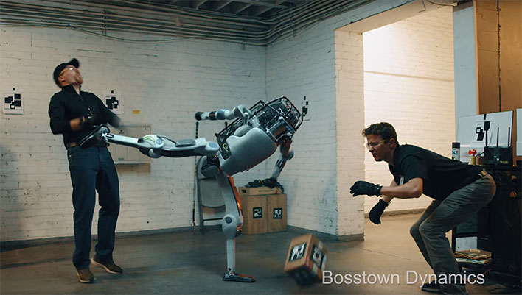
Workout Time!
Python 3 Beginner
Chapter 3 Exercises link
Notes:
https://github.com/cstar-industries/python-3-beginner/blob/master/001-First-Steps/First%20Steps%20-%20Chap%2003%20-%20Exercises.ipynb

Slide 74
Chapter Summary
Python 3 Beginner
This chapter covered the following:
Converting sequence types between one another
Using list comprehensions to create new lists in an expressive yet concise manner
Unpacking iteratable objects with starred expressions
The any and all built-in functions and how to use them to maximum potential with list comprehensions

Slide 75
Cloud Technology Associate
Copyright © 2018 | 9
Q&A
37/39 Avenue Ledru Rollin – CS 11237 – 75750 PARIS CEDEX 12 - info@valnaos.com – www.valnaos.com Tél : 01 86 95 20 48

Slide 76
Workshop
Python 3 Beginner
Session 1 Workshop link
Notes:
https://github.com/cstar-industries/python-3-beginner/blob/master/001-First-Steps/First%20Steps%20-%20Workshop.ipynb

Slide 77
Thank you for your attention!

